Slide 1
IVI Introduction
Autotestcon 2016

Slide 2
What is IVI?
The primary purpose of the Consortium is to:
Promote the development and adoption of standard specifications for programming test instrument
Focus on the needs of the people that use and develop test systems who must take off-the-shelf instrument drivers and build and maintain high-performance test systems
Build on existing industry standards to deliver specifications that simplify interchanging instruments and provide for better performing and more easily maintainable programs
From IVI Foundation By-laws

Slide 3
IVI fit with other specs
SCPI
IVI 4.x(Classes)
Instrument
Capabilities
Scope
DMM
FGen
DCPwr
ACPwr
Swtch
PwrMe
SpecAn
RFSigGn
Counter
DownCnv
UpConv
Digitiz
Programming
Interfaces for
C/C++/C#/VB
LabVIEW, etc
IVI 3.x (Arch)
VXI
plug&play
C
COM
.NET
VISA
C/COM/,NET
message
register
IVI 6.3 PXI plug-in
IO Interfaces &
SW Protocols
PXI-2 and PXI-6: Software
HiSLIP
VXI-11
AXIe 2.0
AXIe 3.1
GPIB
LXI
USB TMC
VXI
PXI
AXIe 1.0
T&M Specific Protocols/Standards
GPIB
Ethernet
USB
VME
PCI, PCIe &
Compact PCI
Physical Connection

Slide 4
IVI fit with other specs
SCPI
IVI 4.x(Classes)
Instrument
Capabilities
Scope
DMM
FGen
DCPwr
ACPwr
Swtch
PwrMe
SpecAn
RFSigGn
Counter
DownCnv
UpConv
Digitiz
Programming
Interfaces for
C/C++/C#/VB
LabVIEW, etc
IVI 3.x (Arch)
VXI
plug&play
C
COM
.NET
VISA C/COM/.NET
message
register
IVI 6.3 PXI plug-in
IO Interfaces &
SW Protocols
PXI-2 and PXI-6: Software
HiSLIP
VXI-11
AXIe 2.0
AXIe 3.1
GPIB
LXI
USB TMC
VXI
PXI
AXIe 1.0
T&M Specific Protocols/Standards
GPIB
Ethernet
USB
VME
PCI, PCIe &
Compact PCI
Physical Connection

Slide 5
IVI Fit with Other Specs
IVI
SCPI
required
VXIplug&play
required
HiSLIP
Instrument
Interface
GPIB
LXI
VXI
PXI
AXIe
SCPI provided necessary standards based on GPIB needs
Command strings natural match to GPIB
HiSLIP allows connection to LXI
VXIplug&play added drivers necessary for VXI
- Used with other I/O to provide necessary driver
IVI enhances VXIplug&play with new features & support for current tools

Slide 6
Comparing Drivers and SCPI
Programming with SCPI
viPrintf(vi, “MEAS:VOLT? %f, %f”, range, resolution); viScanf(vi, &reading);
Program deals with strings sent to/from the instrument
Syntax errors caught by instrument when program is run
Checking for errors requires another sequence to read error
Simple model that requires no driver install
Programming with IVI (IVI-C here)
Ag34410_MeasureDCVolt(vi, range, resolution, &reading);
Program variables sent directly – no chance for SCPI syntax errors
Syntax errors caught by compiler or editor
No performance impact due to string manipulation
Uses debug tools and techniques the programmers knows

Slide 7
What are IVI Drivers – Really??
Architecture specifications
Instrument class specifications
A library of shared software components
4.1 Scope
4.2 DMM
4.3 FGen
4.4 DCPwr
4.5 ACPwr
4.6 Swtch
4.7 PwrMeter
4.8 SpecAn
4.10RFSigGen
4.12 Counter
4.13DownCnv
4.14 UpConv
4.15Digitizer
13 specs @ ~220 pages
Architecture Specifications
3.1,3.2,3.3,3.4,3.5,3.6,3.9,.3.10,3.12,3.17,3.18
~1140 pages of specs
Notes:
Specs
- 3.1 Arch 119 pages
- 3.2 Inherent Cap 178
- 3.3 Cross Class 41
- 3.4 Style 67
- 3.5 ConfigServer 172
- 3.6 Factory 10
- 3.9 C Shared Components 34
- 3.10 MSS 31
- 3.12 FloatingPoint 7
- 3.17 Installation 87
- 3.18 .NET Utility 203
- 4.1 Scope 242
- 4.2 DMM 175
- 4.3 FGen/Arb 202
- 4.4 DC Pwr 76
- 4.5 AC Pwr 176
- 4.6 Swtch 131
- 4.7 PowerMeter 147
- 4.8 SpecAn 106
- 4.10 SigGen 391
- 4.12 Counter 191
- 4.13 DownConvert 179
- 4.14 UpConvert 318
- 4.15 Digitizer 448

Slide 8
The IVI Architectures
IVI Provides: C, COM, and .NET
C dll for environments that use DLLs
COM Components for COM and .NET ADEs
.NET Assemblies for .NET ADEs
Architectures make use of same class definition
Architectures have specific rules for installation, style, etc.
Details in next section

Slide 9
IVI Shared Components
IVI Provides several common components to enable multi-vendor systems (more information in the final section)
C Shared Components
Floating Point Services
IVI-COM Session Factory
Configuration Server
COM Type Libraries
.NET PIAs
.NET Shared Components

Slide 10
What is IVI Compliant -Really??
IVI Compliant
Class Compliant
Common behavior model
Support for IVI Features
Simulation, IO, doc, ….
Standard install
Common API for common tasks
~40 common functions
Simulation, Caching, Open, Close, Initialize, SW Trigger, Status check, Version ….
Consistent API
Common organization, data types, naming
Instrument Class API
Custom API still available
Especially for capabilities beyond the class
Simplifies exchanging instruments

Slide 11
Why IVI? – Simpler to use
Uniform way of doing common tasks
Instantiation, initialization, shutdown
Controlling driver features – state caching, error query, simulation, etc.
Configuration and installation
Fixed locations for binaries, source, headers, documentation, examples
Proper registry entries always made
Common protocol to open/close (standard I/O address is a big benefit)
Consistent solution for managing driver versions
Standard mechanism for handling multi-channel devices
aka repeated capabilities in IVI parlance
Standard error reporting

Slide 12
Why IVI? – Common Features
Key Capabilities that simplify program development
Syntactic Interchangeability
Simulation
Fine grained control through properties
Usable in many ADEs
Documentation of SCPI commands used by function
DirectIO (drivers provide access to SCPI)
Attributes for all parameters (fine grained control)
Buildable source for message based instruments (SCPI)
Tested using a IVI-defined process
IVI-2014

Slide 13





Why IVI? – One Driver for any ADE
IVI Drivers (C/COM/.NET) provide a first class experience in nearly any ADE
Visual Basic 6
Visual C++
Visual C# and Visual Basic.NET
VBA (Excel, Word, PowerPoint)
LabVIEW
LabWindows/CVI
MATLAB
Agilent VEE
C#, VB
C/C++
VB6

Slide 14
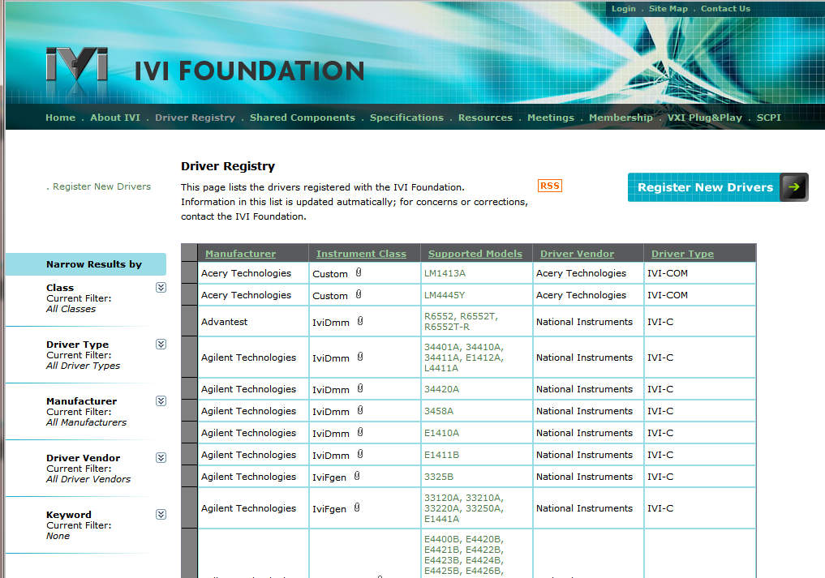
IVI Registration Page
IVI maintains a registration database
IVI requires that drivers claiming compliance be registered
For users:
List of drivers, supported instruments
Mechanism to address defects

Slide 15
Motivations for IVI.NET
Present an API optimized for .NET
Simplify driver source code
Allow end users to understand instrument behavior by examining driver source
Allow end users to modify and add features to drivers on their own
Richer, more expressive APIs
More flexibility with API data types
Clean handling of asynchronous notifications (aka “events”)
Simplified error Handling
Side-by-side deployment of drivers
Only one version of an IVI-COM or IVI-C driver can be installed at a time
IVI.NET allows multiple versions of a driver to be installed

Slide 16
Richer Type System
Both IVI-COM and IVI-C drivers use a limited set of data types
Integers, floats, Booleans, strings
Arrays of the above, but extra parameters are required in IVI-C
IVI-C cannot expose an array of strings
IVI-C cannot expose structs
Can be done in IVI-COM, but it’s tedious to implement
IviScope_FetchWaveform(ViSession vi,
ViConstString channel,
ViInt32 waveformSize, // # of elements on input
ViReal64 waveform[], // actual data buffer
ViInt32 *actualPoints, // # of elements on output
ViReal64 *initialX,
ViReal64 *xIncrement);

Slide 17
Simplifying APIs with .NET TYpes
IVI-C signature
IviDigitizer_FetchWaveformReal64(ViSession Vi,
ViConstString ChannelName,
ViInt64 WaveformArraySize,
ViReal64 WaveformArray[],
ViInt64* ActualPoints,
ViInt64* FirstValidPoint,
ViReal64* InitialXOffset,
ViReal64* InitialXTimeSeconds,
ViReal64* InitialXTimeFraction,
ViReal64* XIncrement);
IVI.NET signature
Channels[].Measurement.FetchWaveform(IWaveform<Double> waveform)

Slide 18
Standard IVI.NET Data Types
IVI Foundation felt it would be useful to offer commonly used data types as part of the IVI.NET Shared Components
Increase consistency amongst IVI.NET drivers
Facilitate data interchange between drivers
Standardized IWaveform and ISpectrum interfaces
Digitizers and scopes and RF spectrum analyzers all read waveforms
Function generators and RF signal generators source waveforms
Without a common definition of a “waveform”, client applications would need to write the tedious code to translate between each class’s notion of a waveform
Time-based parameters can use PrecisionDateTime and PrecisionTimeSpan
No confusion about ms vs sec, absolute vs relative time, UTC time, etc
Precision adequate for IEEE 1588 devices
Common trigger source data type
Useful in “stitching” together devices in triggered source-measure operations

Slide 19
How to deal with Events?
IVI-COM and IVI-C drivers almost never expose events
Exposing something as commonly needed as an SRQ is tortuous
Requires special knowledge/programming by the driver developer
Requires special knowledge/programming by the client programmer
.NET supplies a standard mechanism for exposing events
No special programming required by the driver developer or client programmer
Trivial code to subscribe/unsubscribe
Trivial code for driver developers to customize subscribe/unsubscribe semantics
Warnings can now be dealt with properly in IVI drivers by the use of events

Slide 20
Error Handling in IVI.NET
IVI-C drivers rely solely on return codes
Errors can easily be ignored by the client application
After getting the error code, a second function call is required to get the message
Special handling of warning codes required
IVI-COM error code handling depends upon the client environment
Return codes in raw C++
Special exception classes in C++
COMException class thrown in .NET environments (based on interop)
IVI.NET drivers always use exceptions
User can always see the full context of the error
Error content less dependent upon specific driver implementation
Natural mechanism

Slide 21
More Information
For more information
IVI Website: www.ivifoundation.org
IVI Web Forum: forums.ivifoundation.org
IVI Instrument Driver Fundamentals Course, Getting Started guides and videos: http://www.ivifoundation.org/resources/default.aspx
IVI Specifications: http://www.ivifoundation.org/specifications/default.aspx
IVI Driver Registry: http://www.ivifoundation.org/registered_drivers/driver_registry.aspx
Most vendors have documentation and drivers on their website
For questions on IVI, go to the IVI Web Forum, open an account, and get answers from member companies.
IVI Web Forum: forums.ivifoundation.org

Slide 22

: Kirk Fertitta
Simplifying Test System Development with IVI.NET
Kirk Fertitta
Pacific MindWorks

